Slide 1
Greenfoot Workshop
Bobby - Snake

Slide 2
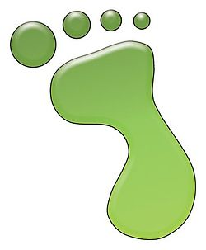
Greenfoot
Ontwikkelomgeving gebaseerd op de Java programmeertaal.
Is gemaakt om de Java taal te leren kennen.
Gemakkelijk om 2D games te maken.
Greenfoot is gratis beschikbaar voor Microsoft Windows, Mac OS X, and Linux.
http://www.greenfoot.org/

Slide 3

De Java taal
« Object georienteerd » taal
Eén van de meest gebruikte programmeertalen te wereld
Ontwikkelen van applicaties voor verschillende systemen
Windows, Mac, Linux, Android, …

Slide 4
« Object Georienteerd »
Java applicaties bestaan uit « Objecten »
Elk Object bestaat uit 2 delen:
zijn eigenschappen
zijn « gedrag », de acties die het object kan doen

Slide 5
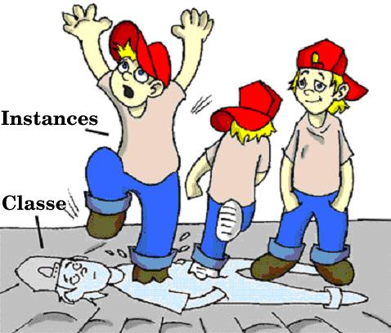
Klassen en Objecten
Om een object te beschrijven,definieren we een klasse.
Een klasse is een « model » waarmee we objecten bouwen.
We kunne ook zeggen dat objecten « instanties » van de klasse zijn.

Slide 6
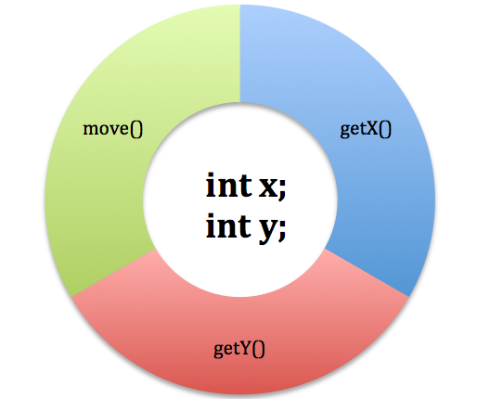
Voorbeeld van een Java klasse
public class GameElement {
private int x;
private int y;
public GameElement(int initX, int initY) {
x = initX;
y = initY;
}
public int getX() {
return x;
}
public int getY() {
return y;
}
public void move(int xMove, int yMove) {
x = x + xMove;
y = y + yMove;
}
}
Notes:
Just to show how it looks like, give a few basic explanations, but do not pass too much time on theory here…
We will introduce the concepts during the workshop based on the game examples.

Slide 7
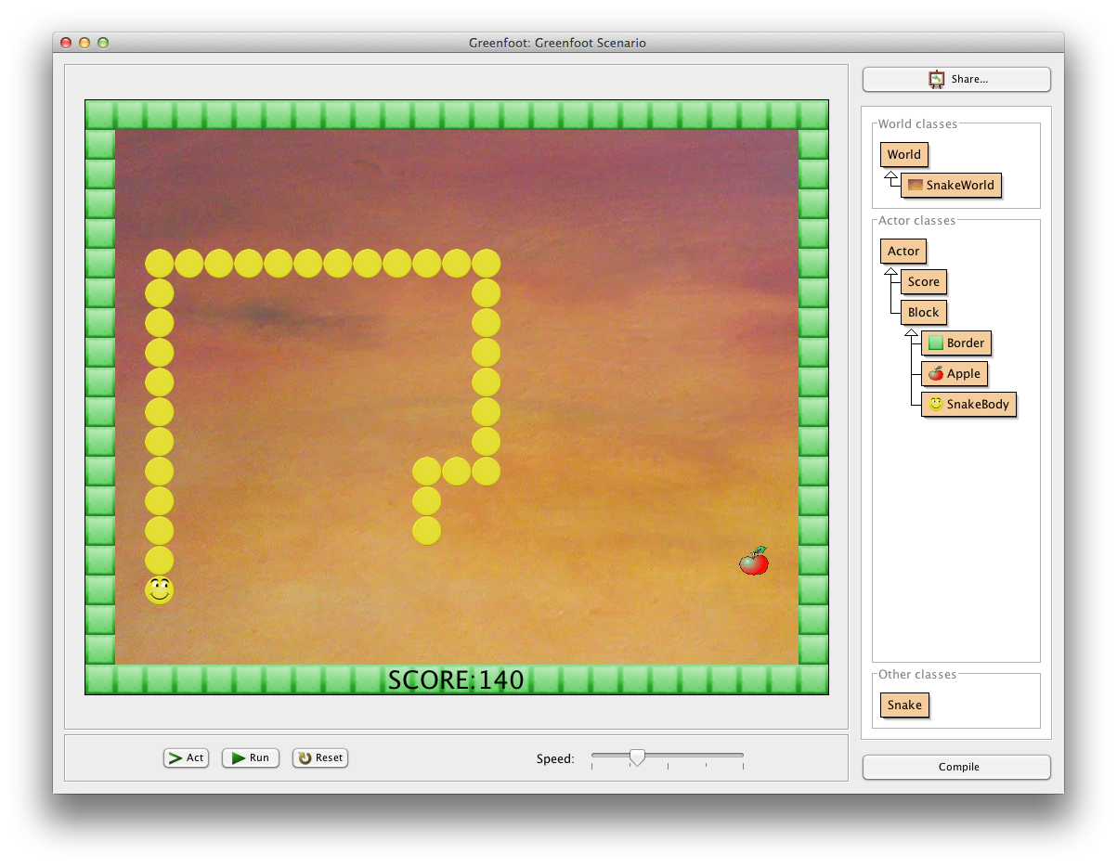
Bobby-Snake
Notes:
Do a quick demo of the game

Slide 8
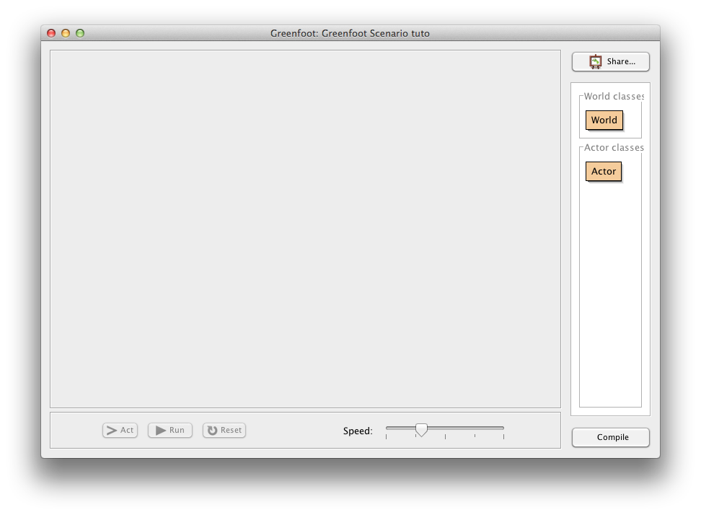
Nieuw scenario
Notes:
Describe the screen:
On the right hand side of the screen, Greenfoot shows two important classes for Greenfoor games
World : This is the game world. This is the main entry point in the game. This class will draw the game screen
Actor : these are the different actors that will “live” in the game (Bobby, apples, border blocks, …)

Slide 9
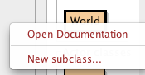
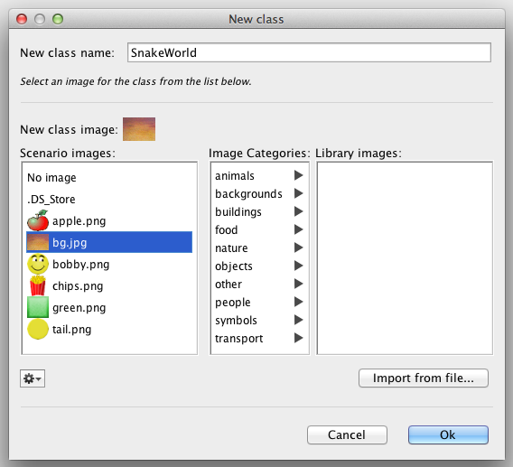
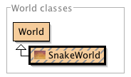
Wereld creëren
Notes:
Right-click on the world, choose « new subclass… »
In the dialog box, enter the name of our class : SnakeWorld
We can also choose a background image for our world. Let’s take bg.jpg
After having clicked on OK, Greenfoot creates a new class, which is a “sub-class” of World.
By double-clicking on this new class, Greenfoot opens a Java code editor.

Slide 10
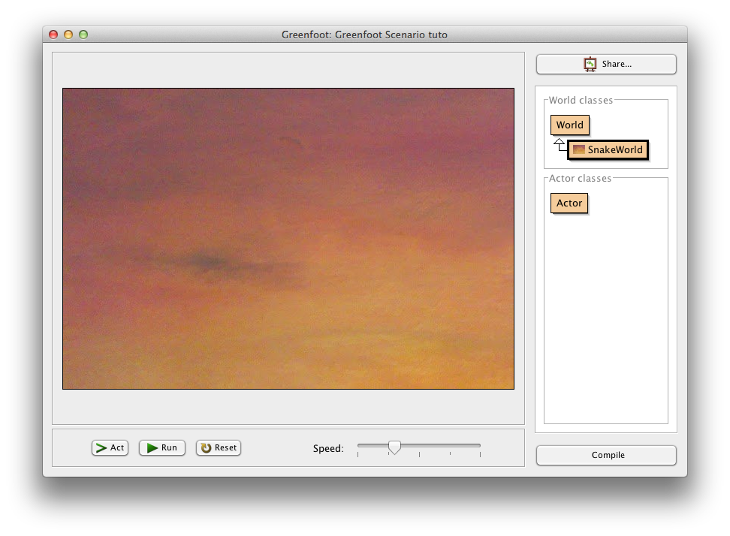
SnakeWorld
Notes:
We will come back on the Java code in a moment, but for now, we will already try to execute it.
For that, we first need to “compile” the Java code. This will analyze the code and translate it into executable code.
Click the “compile” button at the bottom right side of the Greenfoot main screen.
In our case, the execution simply shows the background image.
Within Greenfoot, classes displayed as hatched indicates classes that need to be (re)compiled.
If you want to execute your code, you first need to do a compilation by clicking the « compile » button.

Slide 11
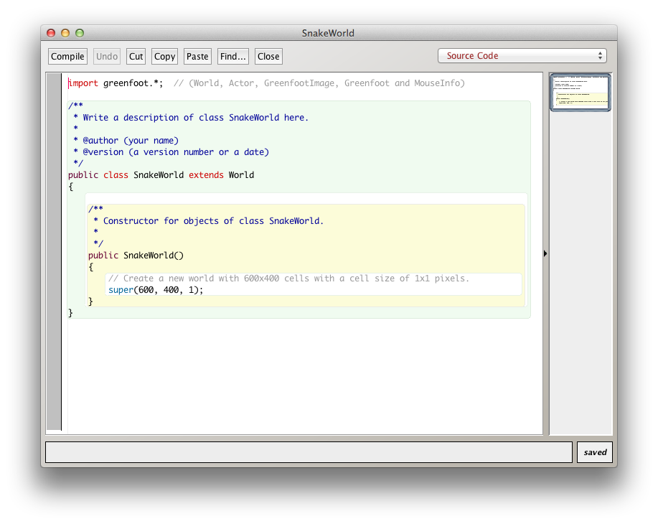
SnakeWorld code
Notes:
Let’s come back on the Java code.
The part « extends World » indicates that our SnakeWorld class « inherits» the characteristics (properties, methods) of the class World. This class is provided by Greenfoot and allows to create the main screen of the game.
Next, we have a « constructor ». Indeed, this is not a method because it does not have any return type and its name is the same as the class name.
The statement « super(600, 400, 1) » actually calls a constructor that is defined on the parent (World) and that allow to « create » the World object by giving it the parameters defining the size of the game screen :
- The first parameter corresponds to the width of the screen to create
- The second parameter corresponds to the height of the screen to create
- The third parameter corresponds to the size of a « block », if we want to have a screen composed of blocks.

Slide 12
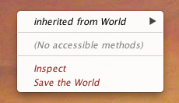
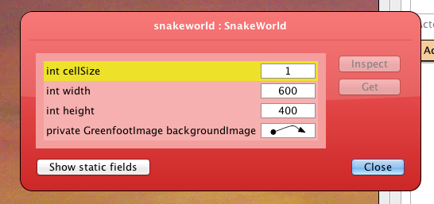
Bekijk World
Notes:
By doing a « right-click » on the game screen, we can also « inspect » the created object (click on « inspect »). We see that the created object is well defined with parameters provided to the constructor.

Slide 13
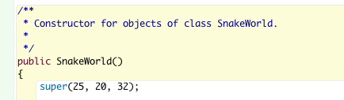
Verander de code
We gebruiken blokken van 32x32 pixels
De grootte van het spel is 25 x 20 blocks
Notes:
Let’s change this code now, to work on a screen composed of blocks of 32x32 pixels, with 25 blocks width and 20 blocks height
Compile your changes and check it by doing an « inspect » of the world.

Slide 14
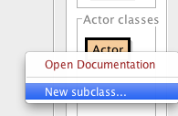
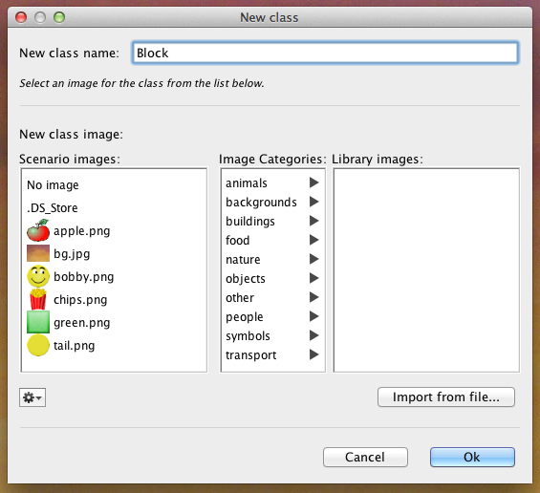
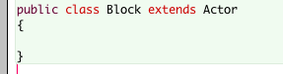
Maak een blok
Notes:
We will start now creating the « Actors » that will be part of our game.
For that, do a « right-click » on the Actor class and select « New subclass… ».
We will create several types of blocks that will be used in our game. For that we will first create a class named Block, that will be a sub-class of Actor (it will hence inherit the characteristics of the Greenfoot Actor class)
For now, we can just keep this class empty: double-click on it to see the code created by Greenfoot and suppress the act() method (we don’t need it).

Slide 15
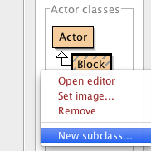
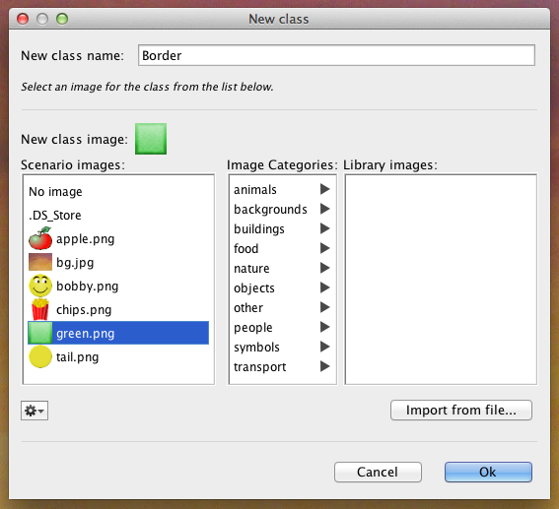
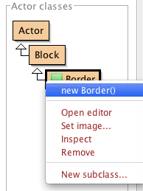
Maak de spelrand
Notes:
Let’s create now a sub-class of our « Block» class we have just created (right-click on Block, then « New subclass… »)
Name the new class « Border» and choose the image « green.png ».
A new class « Boder» appears en below the Actor and Block classes.
By doing a right-click on the Border lass, we can choose the « new Border() » option allowing to create an objet (or « instance ») from our class.
With the help of the mouse, you can position this object anywhere on the game screen (in one of the cells of the screen).
You can do this any time you want to create multiple blocks. And then you can use the « inspect » to inspect the state of each of them.
In their state, you will see the block position (x,y).
You can see that the position of block placed at the top left of the screen is (0,0) and that the x position grows when going to the right, and the y position grows when going down

Slide 16
Coördinaten
(0,0) | (1,0) | (2,0) | … | (24,0)
(0,1) | (1,1) | (2,1) | … | (24,1)
(0,2) | (1,2) | (2,2) | … | (24,2)
… | … | … | … | …
(0,19) | (1,19) | (2,19) | … | (24,19)
Notes:
Block positions are hence organized as shown in the following table

Slide 17
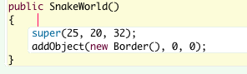
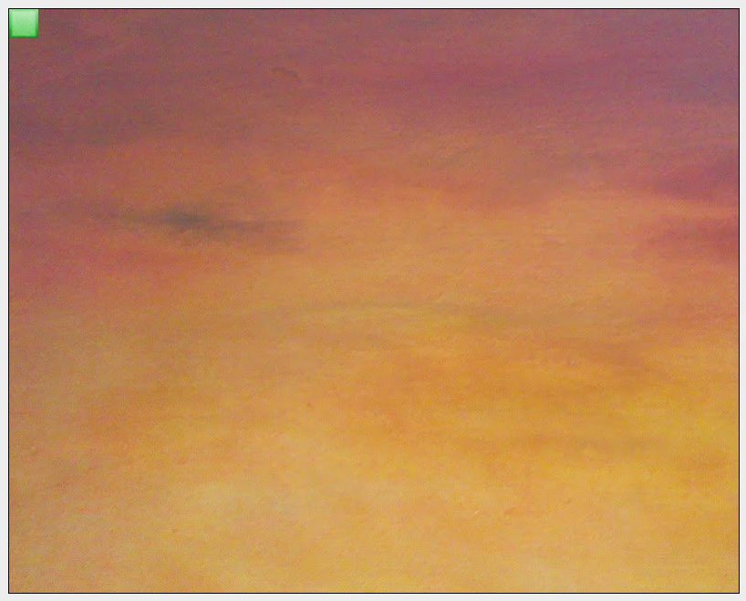
Toon de spelrand
Notes:
To display a border in our world, click on the SnakeWorld class to open it and add the following code
Compile it. You should see a block appearing at the top left corner.
The addObject method is a method inherited from the World class and it allows to display an Actor at a given (x, y) position, passed as arguments. The « new » just before the name of a class allow to create a new Object (or instance) of that class. This corresponds to a call of a constructor on that class.

Slide 18
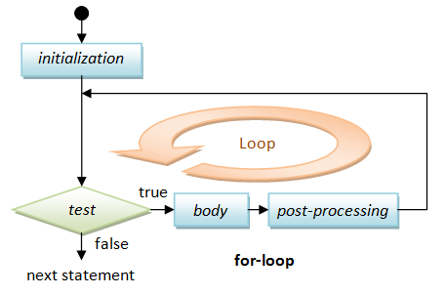
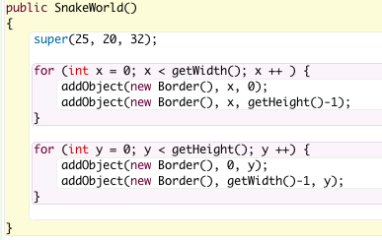
for lussen
for ( initialization ; test ; post-processing ) {
body ;
}
Notes:
To display blocks all around our screen, it would be a little tedious to write down a line of code for each block. For that, we will use a very useful command, the « for loop » of Java.
The syntax of a « for loop » is the following :
The following schema illustrates the execution of that loop:
To display the borders of our game, we will write a first loop that defines a variable x, from 0 to the width of the game. In this loop, we display the blocks on the top and the bottom (note that, as we the first line index is 0, the last line index is the number of lines – 1).
Next, a second loop will define a variable y, from 0 to the game height, and in this loop, we will display the blocks on the left and on the right
A few additional explanations here:
- Variables in Java are always typed, here the type of the variable x and y is int. We will often use this type which represents an integer number (0, 1, 2, …)
- The statement variable = <expression> ; allow to assign the value of the expression to the variable. So, the statement x = 0; allow to initialize the variable x with the value 0.
- All statements in Java always end with ;
- The statement x++ ; allow to add 1 to the variable x. it is equivalent to the instruction x = x + 1 ;
- The methods getWidth() and getHeight() are inherited from the World class and allow to get the width and height of the world.

Slide 19
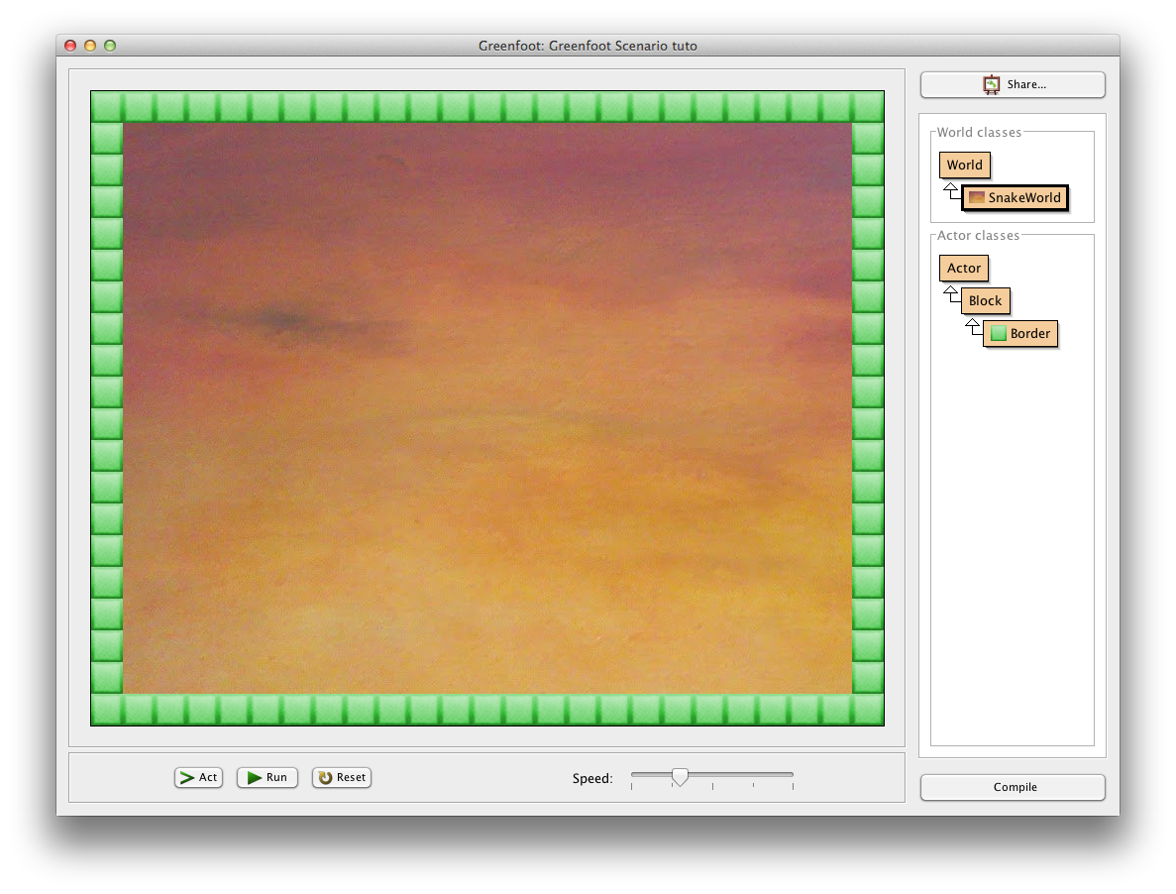
De spelrand
Notes:
Compile your code, you should get the following screen

Slide 20
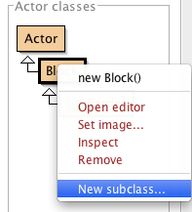
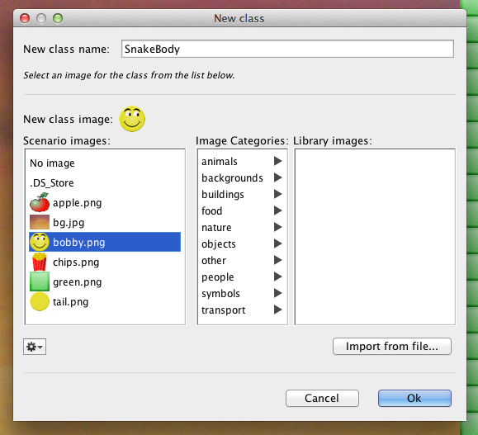
Klasse SnakeBody
Notes:
Create a new sub-class of our Block class
Call it SnakeBody et choose the image of Bobby, bobby.png

Slide 21
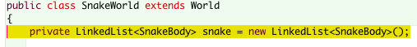
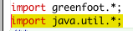
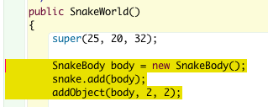
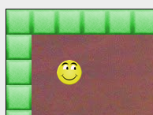
SnakeWorld veranderingen
Notes:
The snake in our game will be a « list » of SnakeBody. For that, the SnakeWorld will define a property so the list of SnakeBody will be part of its « state ».
Open the SnakeWorld class and add the following definition:
This definition creates an empty list of SnakeBody.
To be able to use the LinkedList class of Java, you also need to add at the beginning of the SnakeWorld class, the following instruction:
Next, let’s add the first element in this list, in the SnakeWorld constructor
The first statement creates a new SnakeBody object
La première instruction crée un nouvel objet SnakeBody.
The second one uses the add() method on the snake list, allowing to add a new element (passed as input parameter) at the end of the list
And the third statement, display the new element in the world at the position (2,2), thanks to the use of the addObject() method that we already used to display the borders.
Compile your changes, you should now see Bobby’s head at the position (2, 2).

Slide 22
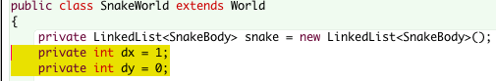
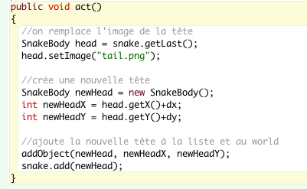
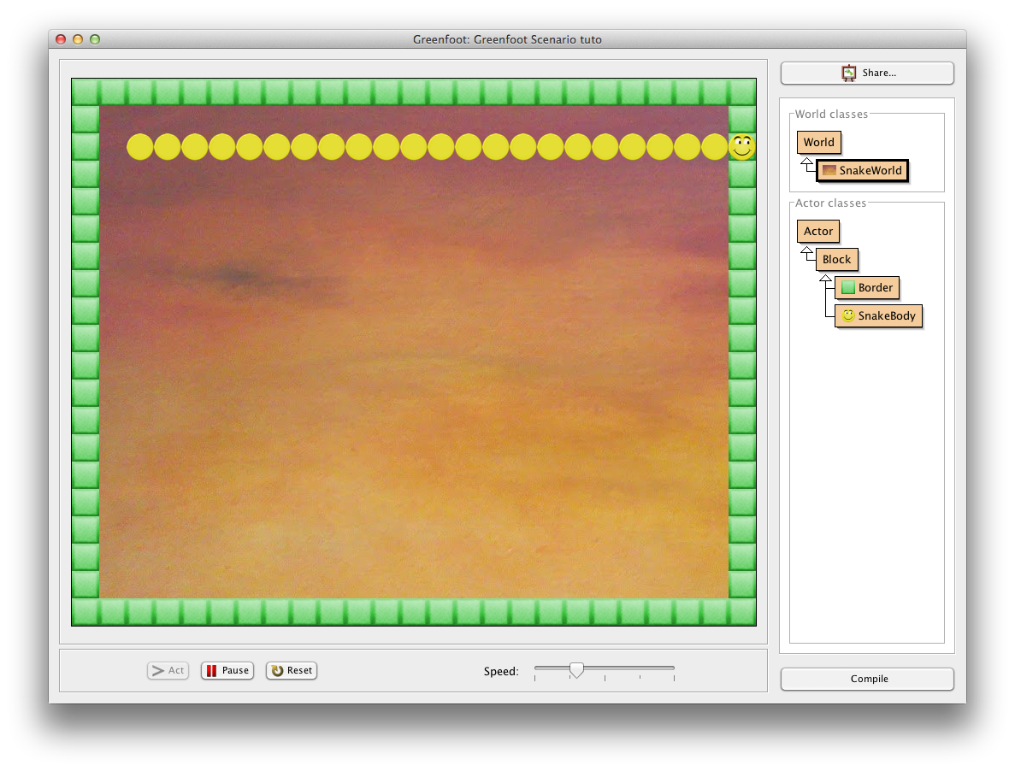
Beweging
Notes:
To know in which direction Bobby is moving, we will add two new properties. One for the direction in the x-axis and one for the direction along the y-axis.
To start with a movement of Bobby to the right, the variable dx is initialize to 1 and dy is initialized to 0.
Now, let’s add a method act() to our SnakeWorld. This method is called by Greenfoot continuously to make the game advance. It calls it on the World and on all the Actors that have been added to the World.
Here follows a first version of the act() method.
In this first version, we take the current head (i.e. the last element in our list). The getLast() method on a LinkedList indeed returns the last element of that list.
Next, we change the image of that element so it becomes an image of the tail element of the Snake.
Next, we create a new head with the statement new SnakeBody(), and we compute the new position of this new head, based on the current position and the current movement direction (dx et dy).
Finally, we add the new head at the position in the world and we also add it to the list of the snake elements
Compile your changes and test the game by clicking « run » (to ask Greenfoot to call the act method continuously).
The snake is indeed going to the right, but it is also growing at each step until it hits the border

Slide 23
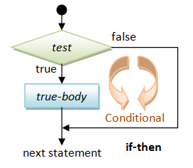
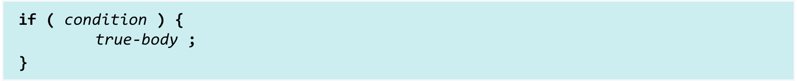
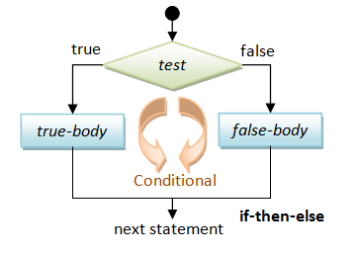
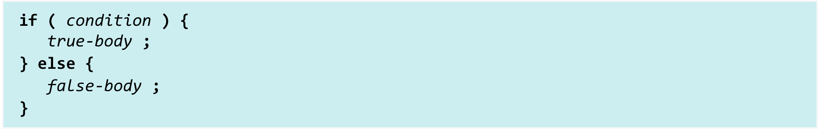
If uitdrukking
Notes:
Before going further, let’s introduce another important programming concept, the if statement.
The syntax of an if statement is the following
And its execution depends on the condition :
Another form of the if statement is the if-then-else allowing to define two behaviors:
Again, its execution depends on the condition :

Slide 24
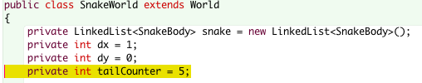
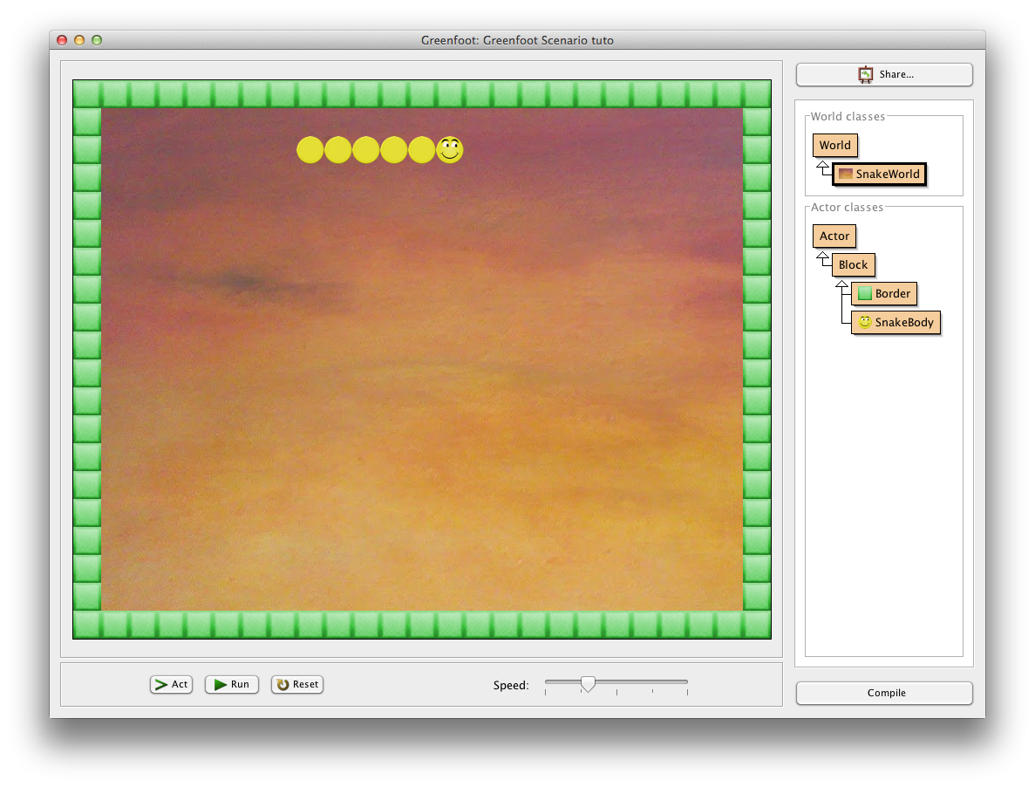
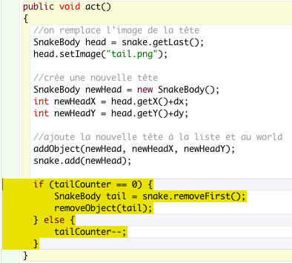
De grootte van de slang
Notes:
In order to limit the size of the snake tail, we will add a new property to the world, indicating how many elements of the tails still need to be created.
In the act() method, after having displayed the new head, we will test the value of this counter:
- If it is equal to 0, we will suppress the laste element of the snake tail (which is actually the first element in our list since we always add the new head to the end of the list).
- Otherwise, we decrement the counter of 1
The removeFirst() method on a LinkedList, remove the first element of the list and returns it.
The removeObject() method, inherited from World, removes the actor passed as argument from the world (and hence suppress it from the screen).
tailCounter-- ; is equivalent to
tailCounter = tailCounter -1 ;
For the 5 first calls to the act() method, the tailCounter is not equal to 0, the snake grows and the tailCounter is decremented of 1.
As soon as the tailCounter is equal to 0, the snake stop growing, as we remove a tail element each time we add a new head

Slide 25
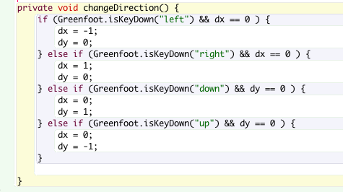
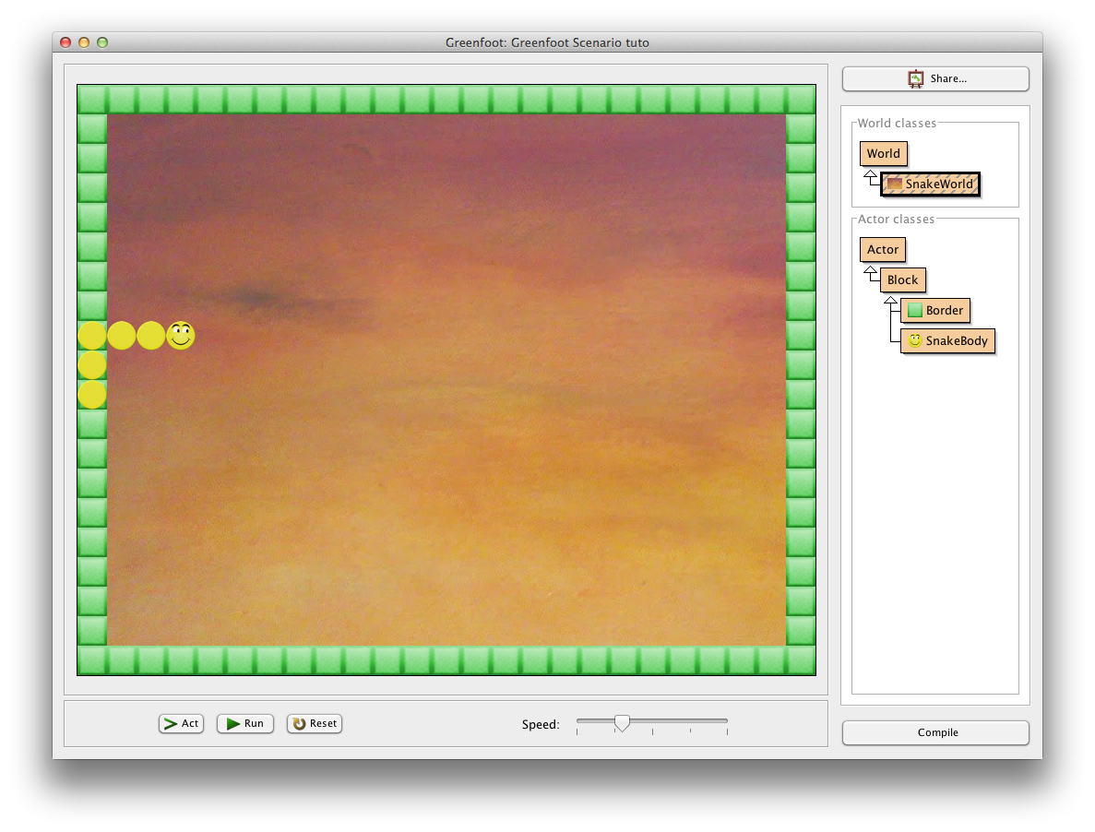
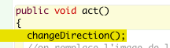
Van richting veranderen
Notes:
Now, we should manage the changes of directions based on the key pressed on the keyboard.
For that, we will create a new method in the SnakeWorld class.
The statement Greenfoot.isKeyDown(« key ») allows to test if a key is pressed
To change the direction to the left or the right, it also requires that the current direction is not already left or right because Bobby cannot turn on himself
We use expressions like the following
Greenfoot.isKeyDown(“left“) && dx == 0
Which can be translated with « the left key is pressed and dx is equals to 0 ». The operator && corresponds to the and, and the operator == compares two values to see if they are equals.
It just remains to call this method at the beginning of our act() method.
Compile your changes and test them.
You can now move Bobby using the keyboard arrow keys.
However, Bobby can go anywhere, even on the borders and he can cross himself

Slide 26
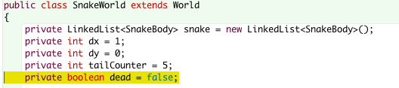
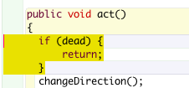
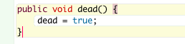
Botsingen (1)
Notes:
Before managing the collisions, we will add a property dead in our SnakeWorld class. It will allow us to stop the game when Bobby has a collision with an obstacle
This property is a « boolean ». This is a simple yet very important type in Java. It can only take two values: true or false
We can then change the act() method so that it does nothing when Bobby is dead
If dead is true, the method directly returns et the game stops
Let’s also add a dead() method on the SnakeWorld, to change the value of dead :

Slide 27
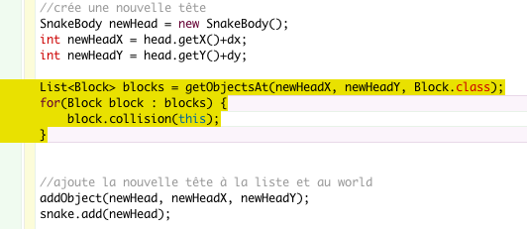

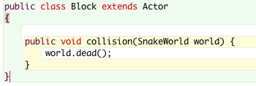
Botsingen (2)
Notes:
Let’s have a look at how to manage « collisions » now. In the act() method, just before displaying the new head, we will check if there is already another block at the position of the new head. So such blocks, we will execute a collision method on the block.
The getObjectsAt() method, inherited from the World class, returns the list of blocks at the x, y position passed as input parameters that are of the type given as the third parameter (for us, Block.class).
So, this method returns a list of Blocks. The following for statement, allows to « loop » on each block of the list and execute the collision() method on each of them.
The « this » passed as parameter allows to pass the current object itself (in our case, the SnakeWorld) to the called method.
At this point, if you compile, there is an error, because the collision() method does not yet exist on the Block class.
Open the Block class and add the collision method:
This method simply call dead() on the world given as parameter. This will directly stop the game.
Compile the change and test it.
The game stops as soon as Bobby goes on the border or if he has a collision with its own tail

Slide 28
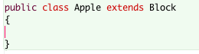
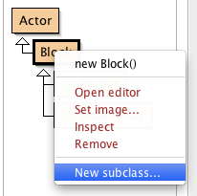

Appelen toevoegen (1)
Notes:
Let’s add now a new subclass of Block and name it Apple. Choose the apple.png image
Open the new Apple class, and delete the act() method

Slide 29


Appelen toevoegen (2)
Notes:
Come back to the SnakeWorld class. At the game initialization (in the constructor), after having created Bobby, we will also create an apple and position it randomly in the game.
The apple is created with new Apple() statement. Then, it is added to the World using the addObject() from Greenfoot. Its position x, y is defined using another Greenfoot method, getRandomNumber(). This method takes a number as argument and return a random number between 0 and the given number. The numbers that are passed to this method are the width and height of the game minus 2 (we do not count the borders) and we add 1 (to avoid being on the border).
Compile your changes and test. Try to catch an apple… What happens ?
The game stops! Indeed, we have programmed our game to stop it as soon as the snake has a collision with a block… and the apple is a block !

Slide 30



Botsing met een appel
Notes:
We will then « override » the collision method in the Apple class
In Java, we can indeed override an inherited method to define a different behavior in a sub-class.
When the snake enters in collision with an apple, we should not call the dead() method anymore, but rather ask the world to make the snake grow (for example of 2 more elements).
In addition, the apple should also be moved elsewhere in the game.
It just remains to add a grow() method in the SnakeWorld class:
It just need to add the number of elements to our tailCounter
Compile and test again. The snake now grows each time it eats an apple !

Slide 31


Geluid
Notes:
To improve our game, we will now add some sound when the Bobby eats an apple or it becomes dies.
To play a sound when Bobby eats an apple, simply add the following code in the collision method of the Apple class:
Compile and test!
The playSound() method takes the name of a sound file as input parameter. This file needs to be in the sounds folder of your Greenfoot project folder.
Also add another sound when Booby dies by adding the following code in the collision method of Block class
Compile and test!

Slide 32
Proficiat!
Je hebt net je eerste Greenfoot spel gemaakt.
Je kan nu nieuwe ideeën aan jouw spel toevoegen of een nieuw spel bouwen.

